Slide 1
WORKPLACE COMMUNICATION SKILLS
Module Code and Version #
MANAGING MEETING 1

Slide 2
Topic & Structure of The Lesson
Introduction of Meeting
Planning and preparation:
-Objective of Meeting
-Agenda
Roles of Chairperson, Secretary, Treasurer and participants

Slide 3
Learning Outcomes
At the end of this module, YOU should be able to:
1. Make the necessary preparations for a meeting to achieve the desired outcomes
2. Conduct an effective meeting

Slide 4
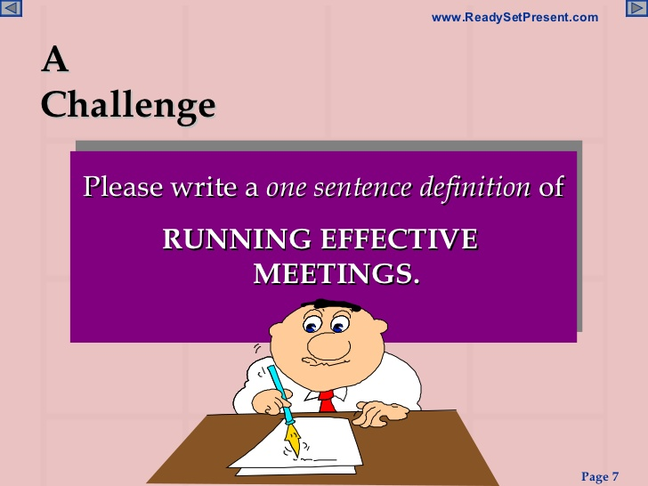

Slide 5
Introduction
Meeting
◆ A meeting is a gathering of two or more people that has been convened for the purpose of achieving a common goal through verbal interaction, such as sharing information or reaching agreement

Slide 6
Purpose of Meeting
The interaction of opinions is necessary to create an idea, plan or project
Group dynamics are essential to the accomplishment of the purpose
Time restrictions limit other options
The subject is sufficiently complex as to require interaction and explanation
The boss/chair/organization says to hold a meeting

Slide 7
Planning a Meeting
»Pre
»In
»After
As you plan a meeting, determine the focus of the meeting
• Decide who should attend
• Choose the best time and place to hold it
• Prepare an agenda for the meeting
• And determine who should take the minutes.

Slide 8
Agenda of Meeting
An agenda sets out the list of items to be discussed at a meeting.
It should include:
The purpose of the meeting; and
The order in which items are to be discussed, so that the meeting achieves its purpose. This will later shape the minutes of the meeting.

Slide 9
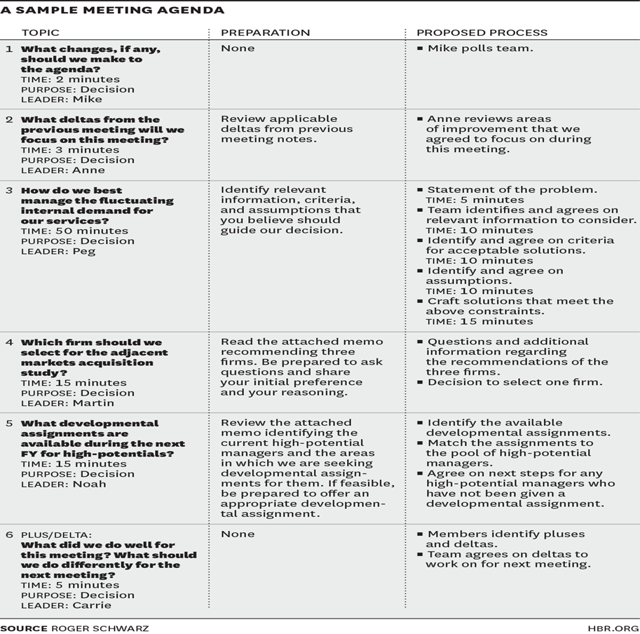

Slide 10
ROLES OF CHAIRPERSON
Prepare for the meeting: focus on purpose and people
Manage the meeting
Establish ground rules
Agree desired outcomes
Agree decision making method
Set and keep to the agenda
Summarise and signpost
Ensure participation
Seek “devil’s advocate”
Adjudicate in disputes
Deal with problem people
Draw to conclusion

Slide 11
Roles of Secretary
makes the arrangements for the meetings, including AGMs, and keeps formal records of the group’s process and decisions: the minutes of the meeting & keeping records of correspondence.
Preparation before, during and after the meeting

Slide 12
Roles of Participant
Know the purpose and prepare
Confirm attendance and be on time
Participate
Keep an open mind
Share your ideas
Behave yourself!

Slide 13
Q & A SESSION

